Slide 1
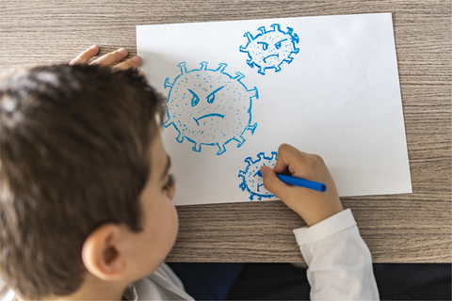
Educators and COVID: Supporting the School Community during COVID-19
Robyne Le Brocque PhD
University of Queensland
Australia

Slide 2
Introduction
The following slides have been adapted from resources developed in Australia to train educators and paediatric mental health professionals to support children following disaster. For more information please contact:
Robyne Le Brocque, PhD, University of Queensland, Queensland, Australia
R.lebrocque@uq.edu.au
We are yet to understand or assess the short- and long-term outcomes of the COVID-19 on the development and academic outcomes for children across all ages.
Our Disastershock Educator Collaboration Group is currently exploring how to assess this impact. For more information please contact:
Brian Gerrard PhD, Western Institute for Social Research, California, USA
brian.gerrard@wisr.edu

Slide 3
Strategies for the Classroom
Monitor symptoms over time**
First step in promoting emotional and mental health outcomes
Remain vigilant and curious about changes in behaviour or family circumstances
Familiarise yourself with ways to arrange help for child
Maintain routines
Structured environments, clear goals, timelines and activities
Advise of changes to routine – weekly agendas etc.
Reduces unnecessary stress and promotes safety and consistency
Important immediately post-trauma and longer-term
Notes:
Monitor symptoms over time** - is probably the single most important thing you can do to directly assist with promoting emotional and mental health outcomes in children. It isn’t the teachers job to counsel or provide assistance for children in need. But teachers are ideally positioned to be able to identify children who require assistance and arrange such assistance.
In addition to monitoring symptoms, there are several things teachers can do in the classroom to promote emotional and mental health recovery.
Maintaining routines – Children generally respond well to structured environments with clear expectations about goals, timelines and activities. Even more important following traumatic events where times have been chaotic and family/home life is generally unstable and unpredictable. It is very important for children to have a stable component in their lives where they can predict what will happen. Helps them know how to behave and promotes a sense of safety and consistency in at least one area of their lives.
Maintaining routines is particularly important immediately following trauma, however, when effects of trauma are ongoing, family circumstances remain unstable, or the child continues to experience difficulties, maintaining routines is also important long term (and is only beneficial for all children).
In terms of routines, also important that children are aware of upcoming events and changes to routines/classroom activities. May be useful to implement daily or weekly agendas and reminding children where necessary of this. For older children, and teenagers, advanced notice of deadlines and major events is required, allowing them to plan for such events.

Slide 4
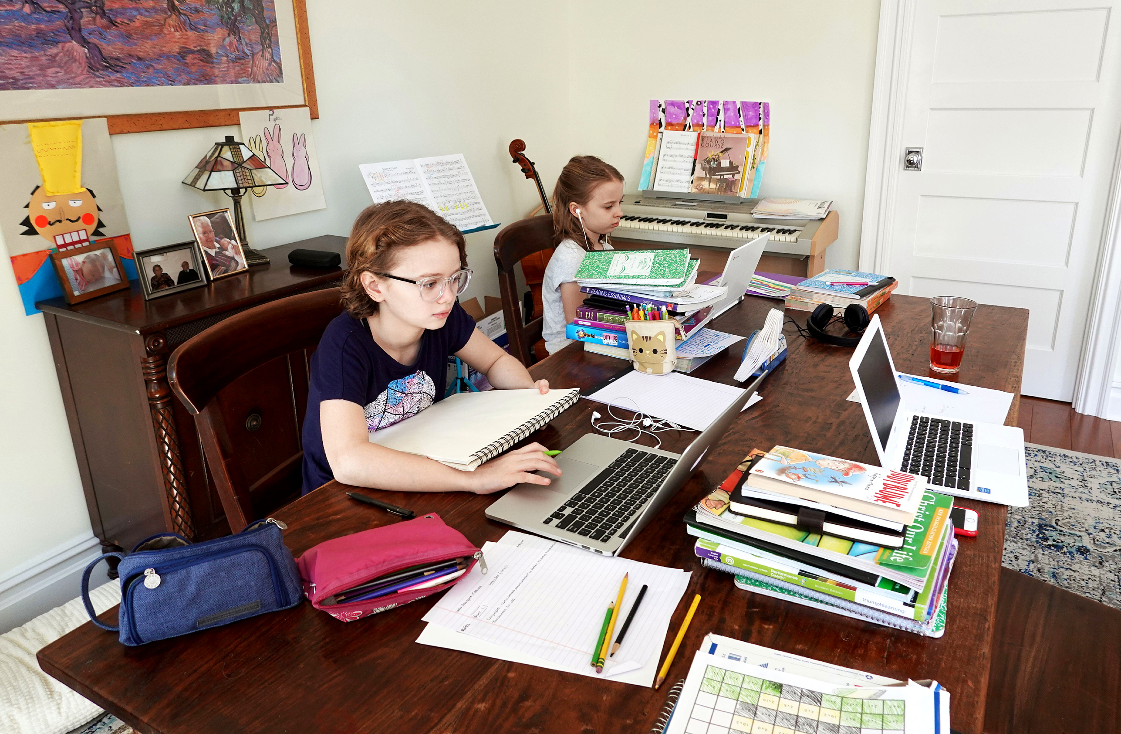
Strategies for the Classroom
Talking about the traumatic event can be helpful but how you talk to child is important
Place rules about disaster talk and amend over time
Contain conversations that encourage fear
Focus on safety, recovery, and rebuilding
Arrange extra support where necessary
Maintain teacher role when sharing experiences
Model calmness
Focus on strengths, positive coping strategies and positive outcomes
Find alternative ways of ‘talking’ (drawing, play)
For older children, can focus on complex issues, relationships
Notes:
Address for vodcast
http://education.qld.gov.au/studentservices/floods/index.html
Talking to the child about the traumatic event:
Misconception that talking about the event can CAUSE problems or CAUSE distress reactions. Talking about the event does not cause the young person to develop problems, but it is important to consider HOW you talk to the young person as there are certain things that may exacerbate distress in the child or model inappropriate coping reactions.
This is particularly true in the longer term. If the child becomes distressed when talking about the event at a later date, then this may be a sign that they are experiencing difficulties and may require some additional assistance.
Play Brett’s vodcast here and invite comments from the teachers about this strategy. Highlight take home message that it is important for teachers to consider and monitor HOW they talk to children about traumatic event.

Slide 5
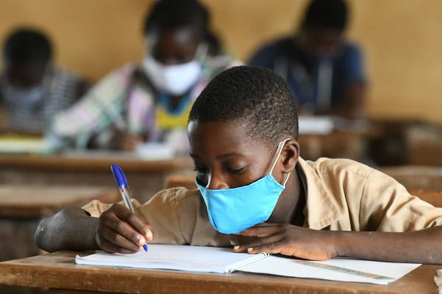
Strategies for the Classroom
Set clear limits/expectations of behaviour
Completion of school work and behaviour in classroom
Adjust way in which you deliver classroom activities to stimulate concentration
Continue with logical consequences for misbehaviour
Note: may need to explore origins of acting out behaviours
Notes:
In the immediate aftermath of the disaster, there obviously might need to be some adjustments in what is expected of children (e.g. wearing uniforms, bringing school equipment etc). However, as routines start to re-establish, it is important for teachers to set clear expectations of behaviour, and rather than generally adjusting expectations relating to completion of schoolwork or behaviour, to consider ways in which you can deliver activities differently that might make it easier for children.
For example, have shorter blocks of time for activities (e.g. 15-30 mins) as children may not be able to sustain attention etc. Incorporate physical activities between activities to stimulate concentration and attention. (e.g stand up and shake it out etc).
If the child is acting out, it is important for teachers to consider that this might be a trauma reaction. Trauma reactions don’t just have to be withdrawn responses. Can present as acting out, this might be an expression of trauma-related anxiety. Important for teachers to explore the origins of acting out and misbehaving, especially where this is a change from the child’s pre-trauma behaviour. These behaviours can take some time to develop and present.

Slide 6
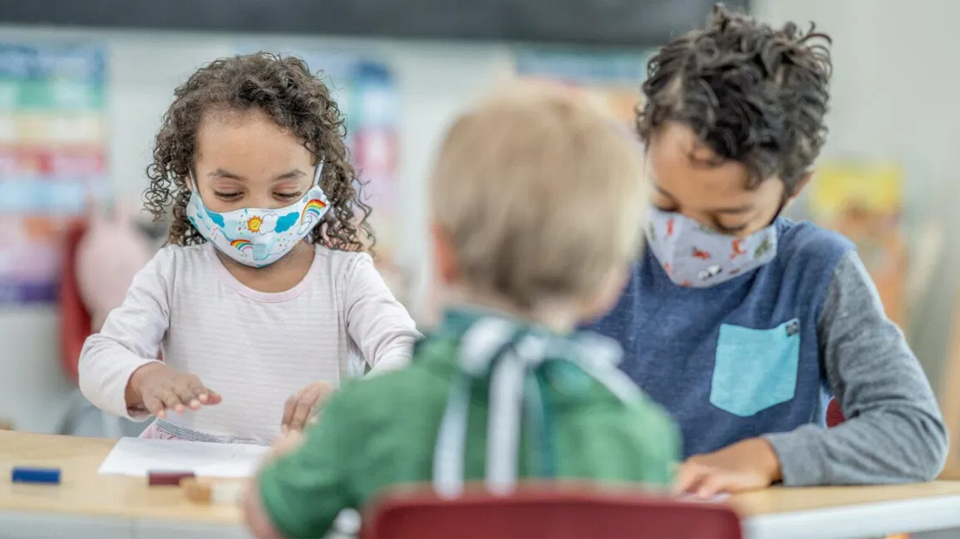
Strategies for the Classroom
‘Buddy’/ ‘support’ system
Convert into sources of emotional/academic support over time
Safe or relaxation spaces
Provide choices where appropriate
Powerlessness and control
Anticipate difficult times and plan ahead
Prepare children for situations that may trigger reactions
Focus on strengths and positives
Reinforce positive coping strategies
Help students build support systems
Notes:
Use a buddy or support system. Often can be particularly useful immediately following disasters. This strategy involves making sure that students are paired with other students to ensure that they have a support person while at school. Might be more appropriate for younger children. Aim is to encourage children to develop relationships that act as sources of emotional support in the future. Although this might be most useful in the immediate aftermath, it may still be beneficial for some students over time (e.g. children with ongoing difficulties, some may not like to be alone, some require additional emotional support). Buddy system can also be useful for classroom activities, group work.
Safe or relaxation spaces. Might also be most useful in immediate aftermath of disaster or intermediate response. Ideally, it can be a good idea to have a section of the room, or a safe space where students can go to calm themselves down if they become overwhelmed while at school. Can also be used if the teacher needs some time to talk to the students individually. It may be necessary for the teacher to set up rules for how the young person can gain permission to visit this space. For younger children, it can be to use special coloured
Provide choices where appropriate. Young people will often feel a sense of powerlessness and loss of control both during and after disasters. For some students (depending on age etc), it may be useful to provide them with some input or choice about some classroom activities. It may help to return a sense of control if they can be involved in decision making. See page 20 of the guide for examples of ways in which children can be involved or offered choices.
Prepare children for situations that may trigger reactions. Some children might be affected by sudden events, noises or triggers that in some way remind them of the traumatic event, or generally invoke a sense of fear (e.g. loud noises, fire drills, storms, rain approaching, turning lights off). Where possible, prepare children for this. For older children, it may be useful to think about any upcoming events or assignments which may trigger reactions. E.g. assignments which involve researching natural disasters or class activities that discuss rain, flooding etc. In some cases, youth may need to be given the option of completing alternative assignments.
Focus on strengths and positives. Following a disaster, there can be a long time where families are focusing on the trauma, and getting their lives back in order. It is very easy here to focus on the negative things happening in their life, including problems managing emotions and behaviours. Often, it is harder to remember to give attention to positive behaviours and coping strategies the young person might be showing. Providing positive reinforcement (eg. Praise) for things the young person does well will help the child to feel good about themselves and also demonstrates to the young person what type of behaviours they should continue to engage in.
This is an easy strategy to use. Can be as simple as offering praise to students when you notice a positive behaviour or personal strength they have developed. The skill requires that teachers practice tuning into positive behaviours (rather than negative ones) and remembering to reinforce these when appropriate. See page 22 of main teacher guide for hints for giving praise and reinforcement. You may want to go through these hints at this point.
Help students build support systems. This is particularly relevant if the student has lost family members, has been relocated, lost community support etc. We know that in times of stress, or for those children who are having difficulty managing emotionally, having a social support system is a protective factor. It can often be important for the student to have multiple sources of support should one not be available. Sometimes this might be as simple as helping students identify people they can talk to.

Slide 7
Trauma, and Self-Care
Notes:
It is only necessary to present the age-related trauma responses that are relevant to the school. Might be useful to present Preschool and middle school reactions together for all primary schools, and only adolescent responses for secondary schools.

Slide 8
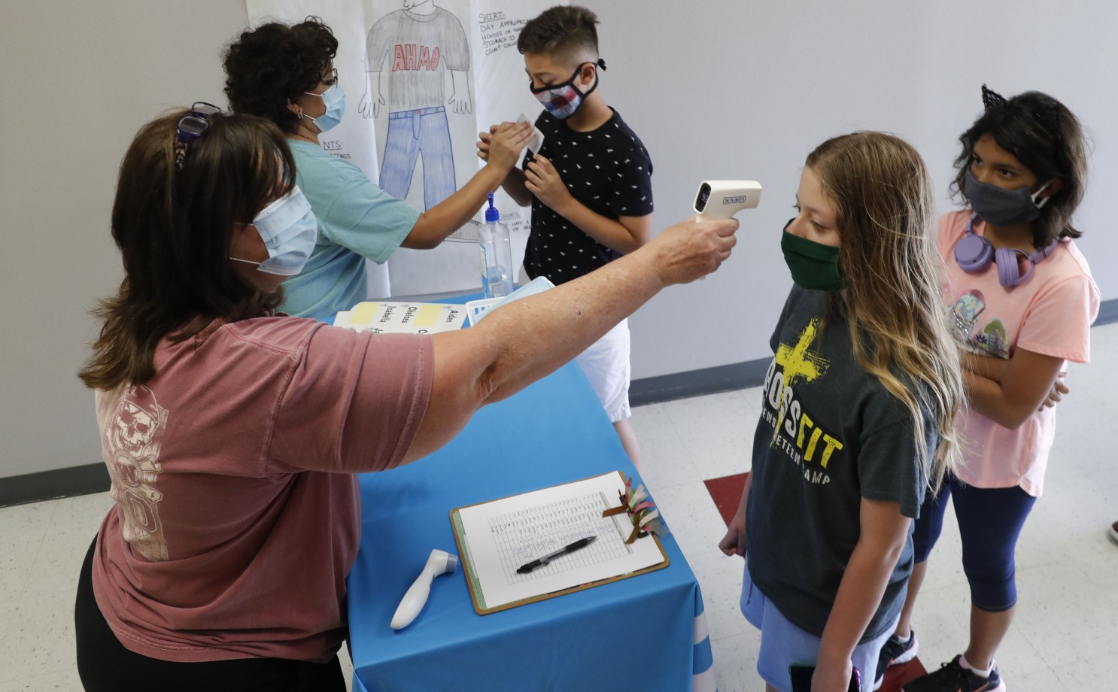
Educators and Traumatic Stress
Reactions may be complicated
Own direct/indirect experiences with the disaster
Own pre-existing stressors
Caring for others who have experienced the trauma
Impact on educators
Physically and emotionally worn out
Overwhelmed by own and others’ experiences
Own traumatic stress resulting
from disaster
Secondary traumatic stress/
compassion fatigue
Notes:
TAKE HOME MESSAGE: Teacher distress and reactions are NOT a sign of weakness. They are a cost of caring for and helping others.

Slide 9
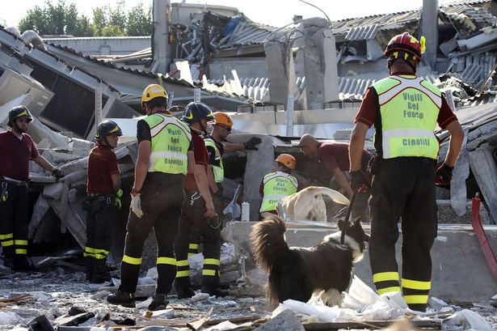
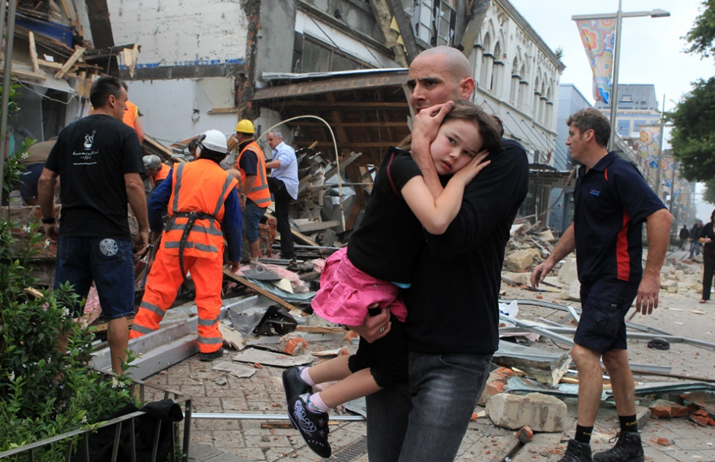
Signs of Secondary Traumatic Stress
Decreased concentration and attention
Increased irritability or agitation (with family, friends)
Difficulty planning activities and maintaining routines
Feeling numb or detached
Intense feelings, intrusive thoughts or dreams about a others experiences (that don’t reduce over time)
Ongoing symptoms
Early identification and intervention important

Slide 10
What can you do? Self-care
Professionals who look after themselves are better able to manage others
Own distress = difficulty reacting in calm and constructive ways
Self-care incorporates:
Identifying own stress
Managing stress levels and emotional reactions
Using helpful coping strategies
Notes:
Teaching as it is can be a particularly stressful job, and taking care of yourselves as teachers is very important. It is now particularly important with the ongoing stressors associated with the natural disaster and the difficulties experienced by students.
Teachers who look after themselves are better able to manage students. When teachers look after themselves, and learn how to manage their own stress reactions, manage their emotional reactions and take care of themselves (mind and body), they are better able to remain calm when reacting to students who are showing difficult or problematic behaviours.
Activity. In this activity, ask teachers to identify ways that they normally take care of themselves and ask them to consider whether these are appropriate now. Brainstorm different things teachers can do to take care of themselves now after the disaster. May be helpful to write ideas on blackboard or overhead projector. Can ask teachers to write ideas down in their notes.

Slide 11
What Can You Do?
Notes:
It is only necessary to present the age-related trauma responses that are relevant to the school. Might be useful to present Preschool and middle school reactions together for all primary schools, and only adolescent responses for secondary schools.

Slide 12
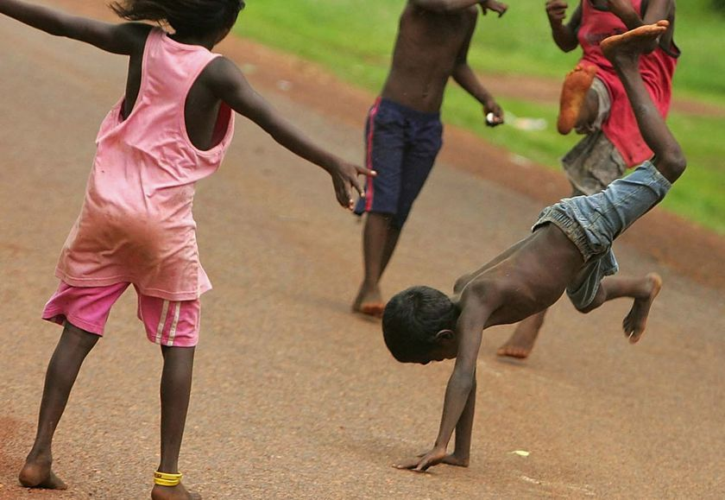
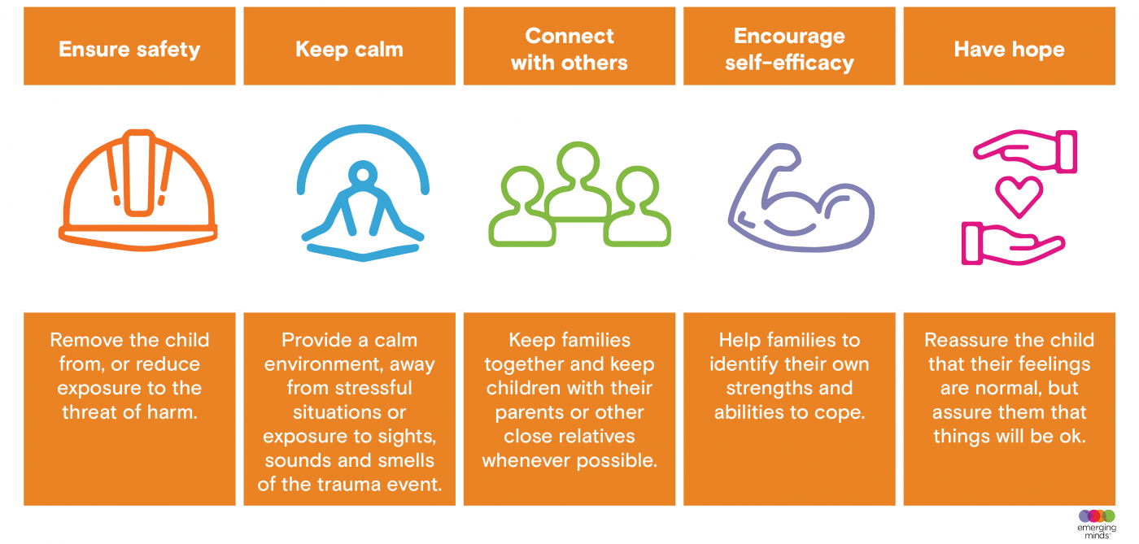
What can you do? Psychological First Aid
https://www.apa.org/practice/programs/dmhi/psychological-first-aid/training
https://learn.nctsn.org/course/index.php?categoryid=11

Slide 13
What can you do? Be aware of psychological reactions
Symptoms persist or worsen over time
Young person shows a significant decline in performance
Problems interfere with daily functioning or cause significant distress
Specific (ongoing or worsening) problems regulating emotions (e.g. difficulty controlling crying, anger)
Significant and lasting changes in social functioning

Slide 14
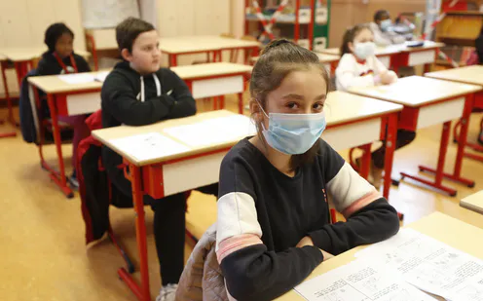
How to get help?
Utilise school-based resources such as school counsellors
Become familiar with available resources and support staff
Use community-based resources such as help lines, parenting support, and web-based resources
https://istss.org/public-resources/covid-19-resources
Seek professional help for those with deteriorating mental health – early intervention prevents more serious mental health problems
Notes:
Ask teachers to tell you what sort of school-based resources might be available to them, should they identify a child who requires further assistance.

Slide 15
The Role of Teachers Post-Trauma
Continue being a good educator
Continuing and supporting children’s education
Be aware of possible trauma reactions and how they may affect child, teacher and classroom
Be prepared to refer for further assistance
Notes:
Activity – ask teachers to brainstorm what the most useful strategy is they have found since having the kids back in the classroom.

Slide 16
Screening, Assessment, and Referral
We need:
Better screening tools
Stronger partnership between schools and mental health specialists with child expertise
Stronger pathways for referral of children, families, and educators who may be experiencing difficulties
Resources to support children and educators over the short– and long-term
A comprehensive planned disaster response

